Slide 1
Trees and Rotations

Slide 2













Slide 4











Slide 5






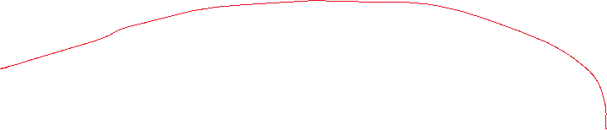

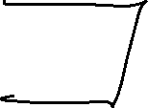
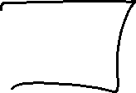






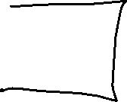





Slide 6
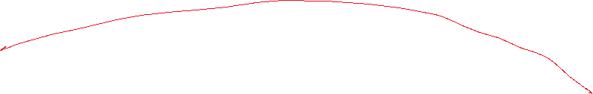

Slide 7
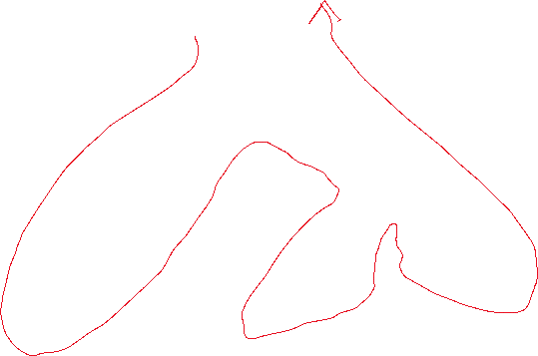


Slide 9
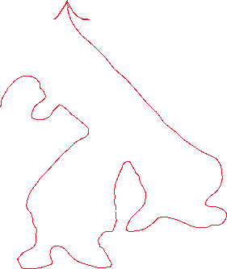


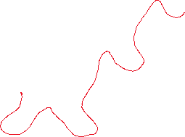

Slide 10





Slide 11
A tree which is not balanced is inefficient to search. A degenerate tree where all items are inserted in ascending or descending order has the appearance and efficiency of a list (O(n)). A balanced tree is searchable in O(log n) time.

Slide 12









Slide 13






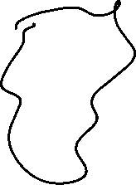



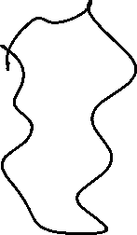




Slide 14






Slide 15
In this case of imbalance, the path from the point of imbalance to the new node starts with going Right, and Right Again. Usually shortened to RR.
To correct this situation for an AVL tree we need to perform a RR-Single Rotation operation.

Slide 16






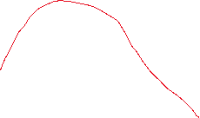



Slide 17















Slide 18





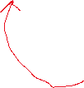




















Slide 19













Slide 20



30, 10, 20, 40, 50, 25, 5, 3, 4, 35, 45, and 2

Slide 21












30, 10, 20, 40, 50, 25, 5, 3, 4, 35, 45, and 2

Slide 22



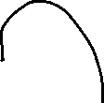





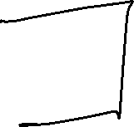








Slide 23


